Slide 1
2nd Assignment
Machine Learning II
Master in Business Analytics and Big Data
acastellanos@faculty.ie.edu
LDA/QDA
1

Slide 2
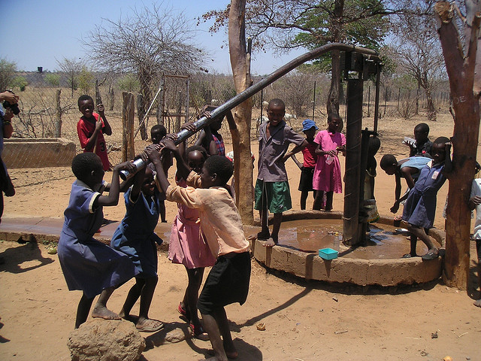
Pump it up!
Help Tanzanian Ministry of Water
Can you predict if and when a water pump is going to fail?
https://www.drivendata.org/competitions/7/pump-it-up-data-mining-the-water-table/
LDA/QDA

Slide 3
Details
Multiclass Classification Task
Apply any of the algorithms we have explained in class to address the task: Regression, Decision Trees, Naive Bayes, KNN...
R or Python
Dataiku for Data Cleaning and Feature Engineering
Group Assignment
LDA/QDA

Slide 4
Recommendations
Take a look to the problem description. Understand the problem!
Feature Engineering is important for this dataset.
Decision Trees are expected to offer the best results. However, be open to test some other methods.
Review caret (for R) and sklearn (for Python).
Useful kernels and sample code about this dataset.
LDA/QDA

Slide 5
Submission
The Markdown, Notebook or code you have implemented to generate your results. (It has to work!)
If you use Dataiku, you have to explain the process that you have conducted to prepare your dataset
The CSV with your submission.
Your username and score for the competition
LDA/QDA

Slide 6
Evaluation
Final Score in the competition (20%)
The ML Pipeline in your markdown (80%)
Explain your work
Justify your decisions
Compare several models and ideas
Analyze the results
LDA/QDA

Slide 7
Deadline
November 3rd, 11:59 PM
LDA/QDA

